Slide 1

Process Mining Virtual Internship
by
G SRIJITHA
Roll No. 224G1A3295
Department of Computer Science and Engineering (Data Science)
Srinivasa Ramanujan Institute of Technology
(Affiliated to JNTUA & Approved by AICTE) (Accredited by NAAC with ‘A’ Grade & Accredited by NBA (EEE, ECE & CSE)
Rotarypuram Village, B K Samudram Mandal, Ananthapuramu – 515701.
2024 - 2025

Slide 2

Contents
Process Mining Virtual Internship
Course Objective
Introduction
Technology
Applications
Modules
Real Time Examples
Learning outcomes
GitHub Dashboard
Queries
224G1A3295

Slide 3
Course Objective
Process Mining Virtual Internship
Gain in-depth knowledge of Celonis’ EMS (Execution Management System) and its role in analyzing and optimizing business processes.
Learn how to identify inefficiencies, derive actionable insights, and implement solutions that drive business value.
Develop technical skills in process automation, data integration, and analysis using Celonis tools.
Choose from specialized tracks (Business, Technical, Automation, or Research) to tailor the program to their career goals.
Upon completion, participants will earn a Celonis Rising Star badge, demonstrating their expertise and readiness to apply process mining methodologies in real-world scenarios.
224G1A3295

Slide 4
Introduction
Process Mining Virtual Internship
As a recent participant and completer of the Celonis Rising Stars Program, I embarked on a transformative learning journey that deepened my understanding of process mining and its impact on business performance. Over the course of the internship, I gained hands-on experience with Celonis’ powerful Execution Management System (EMS), learning how to analyze processes, identify inefficiencies, and propose actionable solutions.
Through the program’s specialized tracks, I was able to refine my technical and analytical skills, applying them to real-world business challenges. This internship has equipped me with the tools and knowledge to drive business value, streamline operations, and explore innovative approaches to process automation and optimization.
In this presentation, I will share insights from my internship experience, highlight key takeaways, and showcase the knowledge and skills I've acquired in the realm of process mining and data-driven decision-making.
224G1A3295

Slide 5
Technology
Process Mining Virtual Internship
In the Celonis Rising Stars Program, I worked with the following key technologies:
Celonis EMS: A platform for visualizing and optimizing business processes using process mining.
Process Mining: Analyzing event logs to identify inefficiencies and improvement opportunities.
Celonis Studio: A tool for building custom dashboards, analyses, and automating workflows.
PQL (Process Query Language): Writing advanced queries to perform in-depth process analysis.
Process Automation: Automating workflows with Action Flows for faster, more efficient operations.
Data Integration: Extracting and transforming data from enterprise systems for real-time analysis.
224G1A3295

Slide 6
Applications
Process Mining Virtual Internship
Celonis: Visualizes and analyzes processes.
Features: User-friendly interface, process mapping, root cause analysis.
PROM: Open-source application for research and industry.
Features: Plugin-based architecture, customizable algorithms.
ProcessGold: Optimizes processes with advanced analytics.
Features: Automatic process modeling, predictive capabilities.
Minit: Simplifies process discovery for non-technical users.
Features: Easy interface, performance metrics.
QPR Process Analyzer: Combines process mining with analytics.
Features: Real-time monitoring, in-depth insights.
224G1A32195

Slide 7
Modules
Process Mining Virtual Internship
Modules Overview –
Data Collection & Preprocessing: Extracting data from systems, cleaning it, and preparing event logs for analysis.
Process Discovery: Visualizing real-world processes using models like Petri nets, identifying the actual flow of activities.
Conformance & Performance Analysis: Comparing processes with expected models, evaluating performance metrics to find inefficiencies and bottlenecks.
Optimization & Predictive Analysis: Redesigning processes for efficiency and using predictive analytics to forecast issues and adjust proactively.
Visualization & Continuous Monitoring: Creating visual reports to aid decision-making and continuously monitoring processes to sustain improvements.
224G1A3295

Slide 8
Real-Time Examples
Process Mining Virtual Internship
Process mining has a wide range of applications across industries, including:
Supply Chain Optimization: Identifying bottlenecks and inefficiencies to streamline operations.
Healthcare: Improving patient treatment pathways and resource allocation.
Manufacturing: Monitoring production processes to detect and resolve issues in real-time.
Financial Transactions: Detecting fraud by analyzing patterns in transaction logs.
IT Service Management: Optimizing service request flows and enhancing incident resolution.
Logistics: Tracking delivery routes and optimizing the supply chain.
Customer Journey Analysis: Understanding customer behavior to enhance experience and strategies.
Energy Management: Reducing costs by identifying energy inefficiencies.
224G1A3295

Slide 9
Learning Outcomes
Process Mining Virtual Internship
Mastered Process Mining Fundamentals
Developed a solid understanding of core process mining concepts and methodologies.
Specialized in Technical Skills
Gained in-depth knowledge of technical aspects, including data integration and algorithm implementation.
Acquired Practical Experience
Engaged in hands-on work with advanced process mining tools for effective data analysis and visualization.
Implemented Automation Techniques
Learned to automate processes and optimize workflows using process mining insights.
Earned the Rising Star Badge
Successfully completed the program and received the Rising Star Badge, enhancing my qualifications in the job market.
224G1A3295

Slide 10
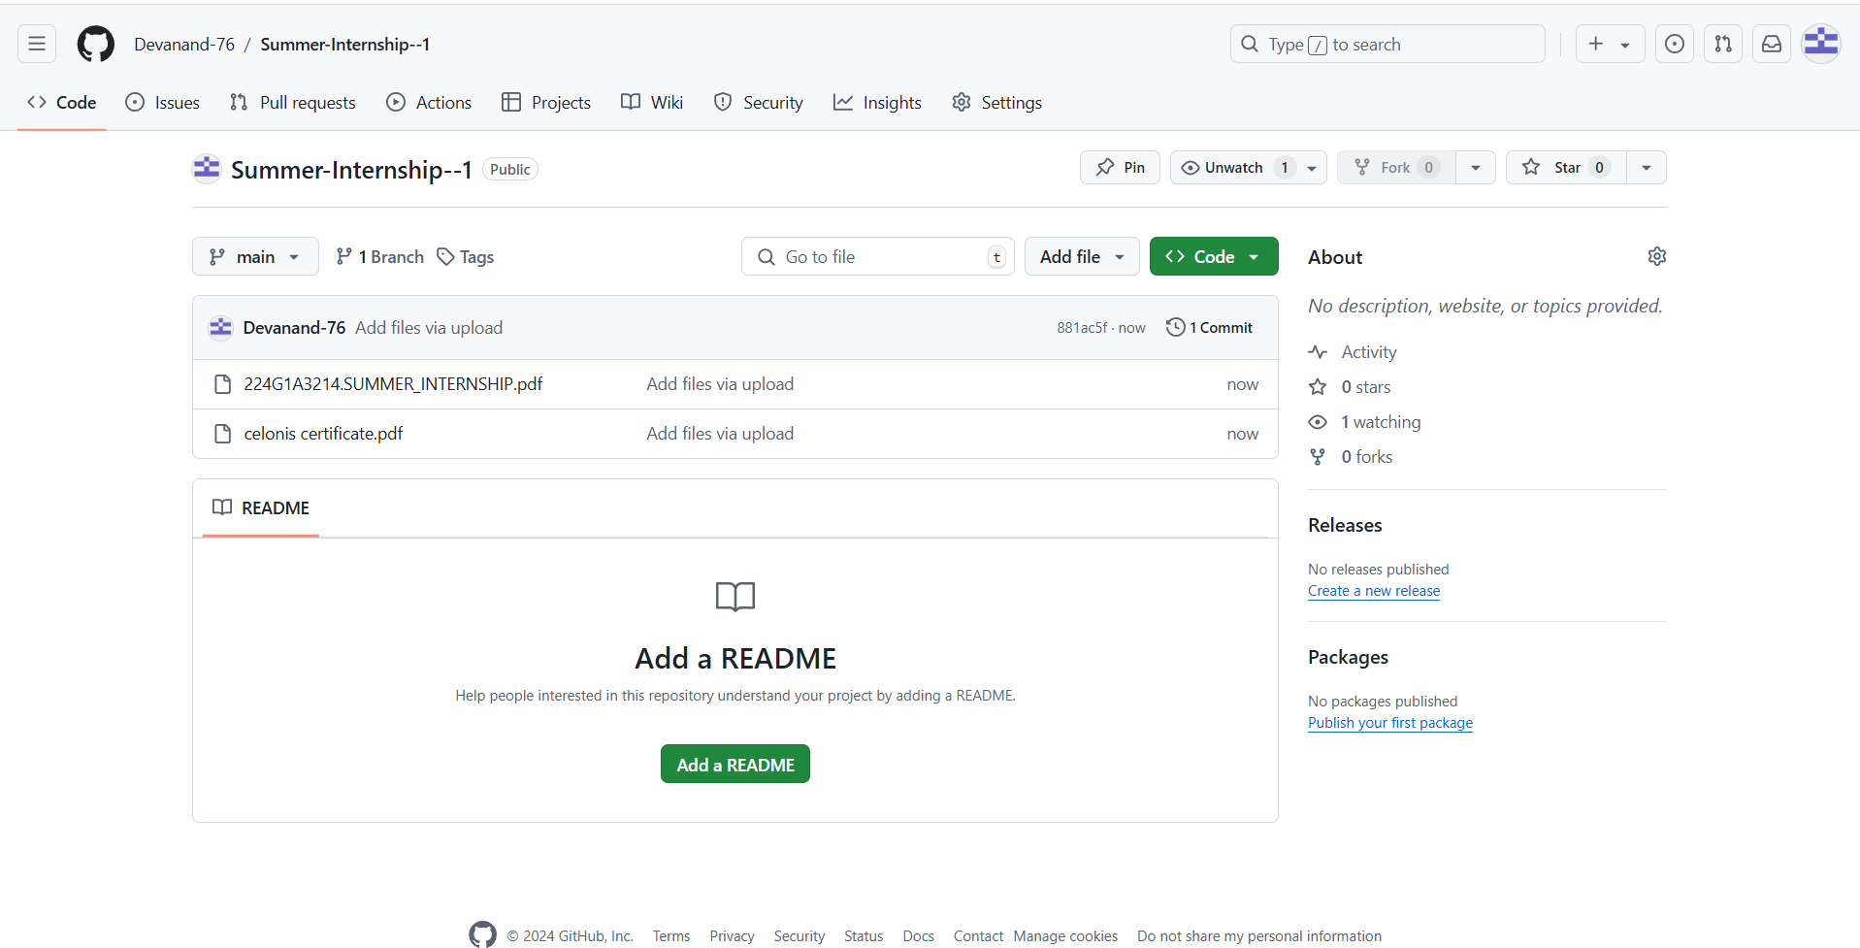
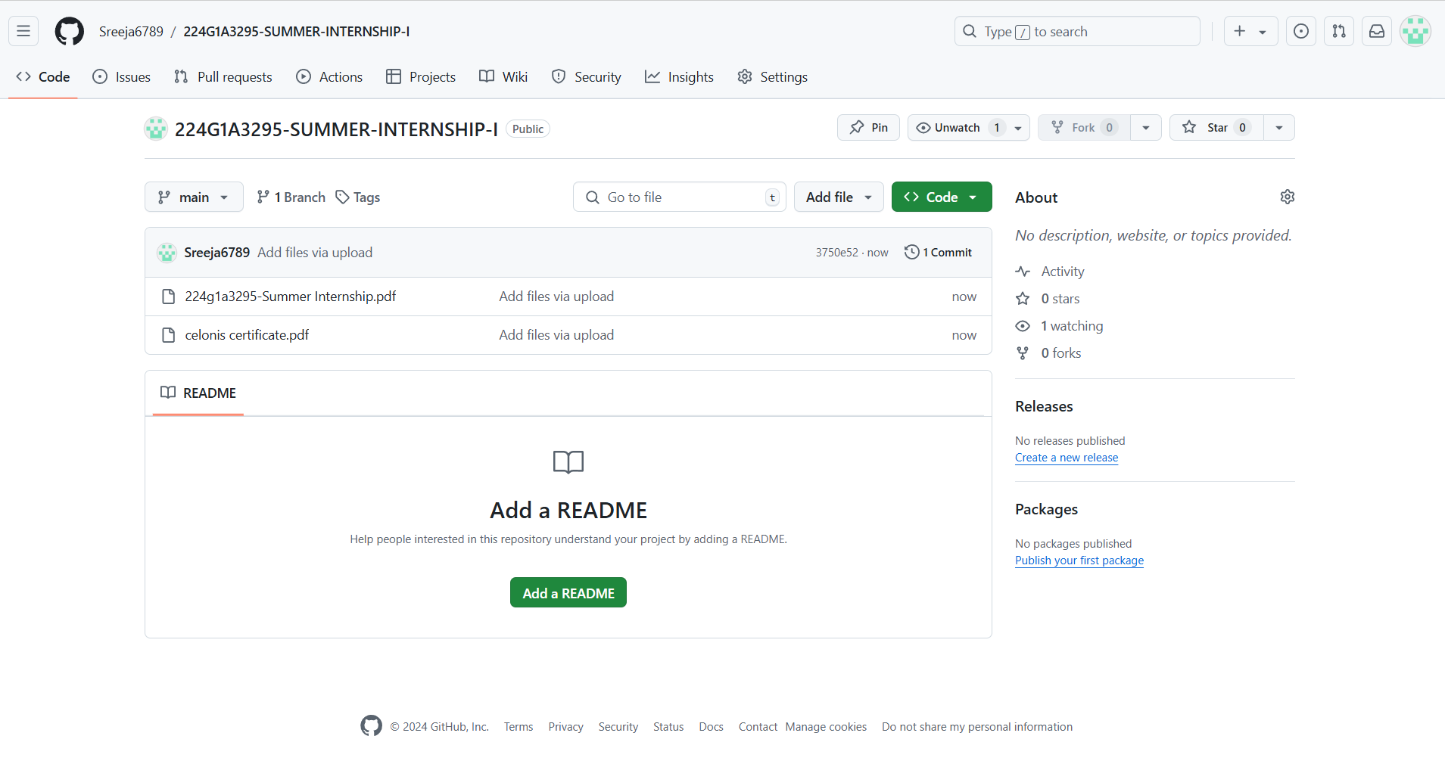

Git Hub Dashboard
Process Mining Virtual Internship
Repository Link:https://github.com/Sreeja6789/224G1A3295-SUMMER-INTERNSHIP-I
224G1A3295

Slide 11
Process Mining Virtual Internship
Any Queries?
224G1A3295

Slide 12
Process Mining Virtual Internship
Thank You!!!
224G1A3295

